Slide 1
2015-2016 Beverly Cleary Children’s Choice Award Nominations
Sponsored by OASL

Slide 2
To vote for your favorite BCCCA book, read (or listen to)
at least two of the following nominated books...

Slide 3
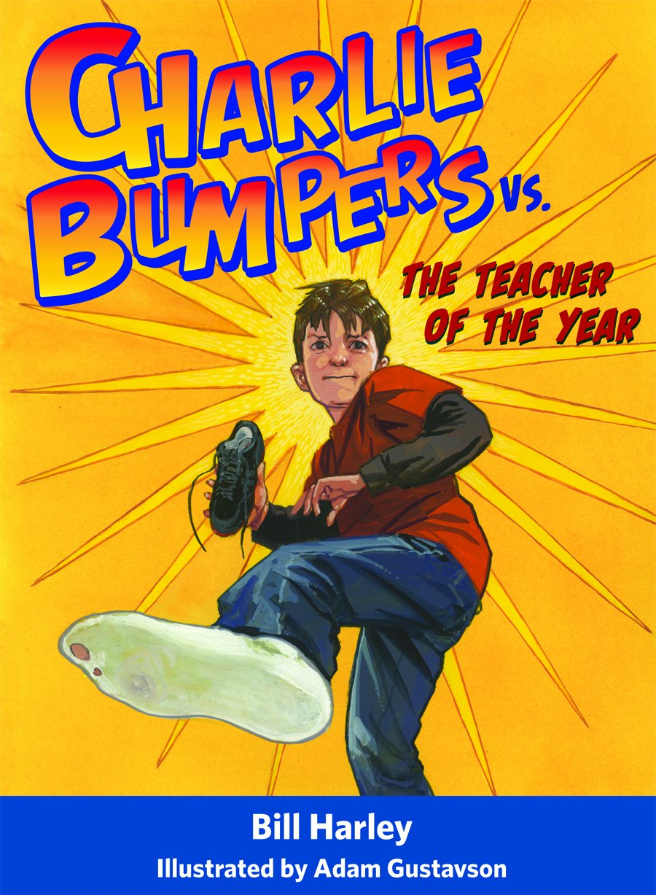
Charlie Bumpers vs. The Teacher of the Year by Bill Harley
Shortly before school starts, Charlie Bumpers learns that he will have the strictest teacher in the whole school for fourth grade. It doesn't matter that she's been named Teacher of the Year. He's still afraid of her. Last year when he was horsing around in the hall, he accidentally hit her in the head with his sneaker (don't ask). How will he survive a year under a teacher who is just waiting for him to make another stupid mistake?

Slide 4
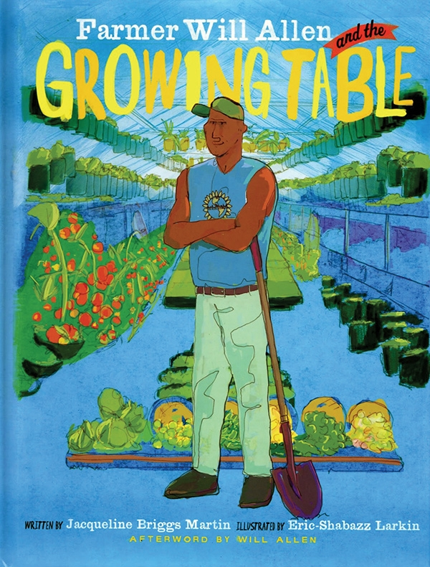
Farmer Will Allen and the Growing Table By Jacqueline Briggs Martin
Will Allen is no ordinary farmer. A former basketball star, he's as tall as his truck, and he can hold a cabbage, or a basketball, in one hand. But what is most special about Farmer Will is that he can see what others can't see. When he looked at an abandoned city lot he saw a huge table, big enough to feed the whole world. No space, no problem. Poor soil, there's a solution. Need help, found it. Farmer Will is a genius in solving problems.

Slide 5
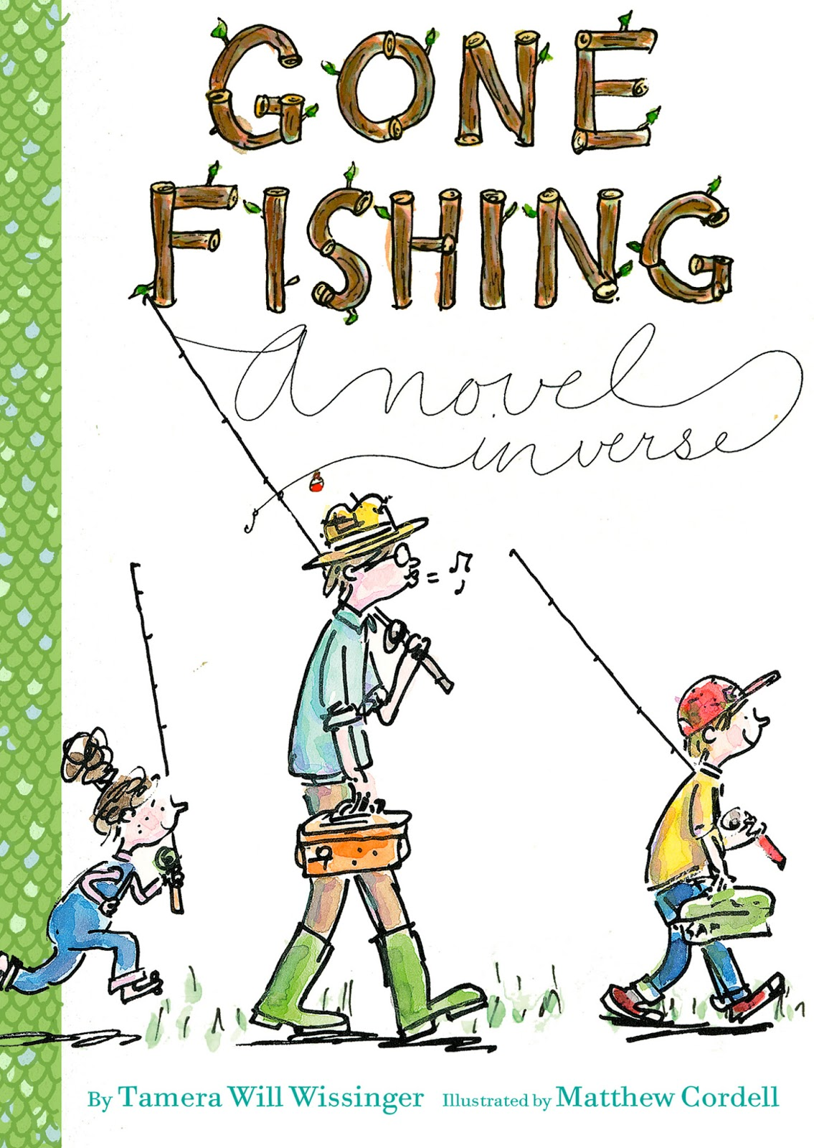
Gone Fishing: A Novel in Verse by Tamera Wissinger
Nine-year-old Sam loves fishing with his dad. So when his pesky little sister, Lucy, horns in on their fishing trip, he’s none too pleased: “Where’s my stringer? / Something’s wrong! / The princess doll does not belong!” All ends well in this winsome book of poems—each labeled with its proper poetic form, from quatrain to tercet. Together the poems build a dawn-to-dusk story of a father-son bond, of sibling harmony lost and found—and most of all, of delicious anticipation.

Slide 6
The Mystery of Meerkat Hill: A Precious Ramotswe Mystery for Young Readers By Alexander McCall Smith
Precious wants to be a detective when she grows up. She is always practicing at being a detective by asking questions and finding out about other people’s lives. There are two new students in her class, a girl called Teb and a boy called Pontsho. She learns that they are brother and sister, and—even more exciting—that Pontsho has a clever pet meerkat named Kosi. One day, Teb and Pontsho’s family’s cow disappears. Precious helps them look for clues to find the cow. But getting the cow back home will require some quick thinking and help from an unexpected source.

Slide 7
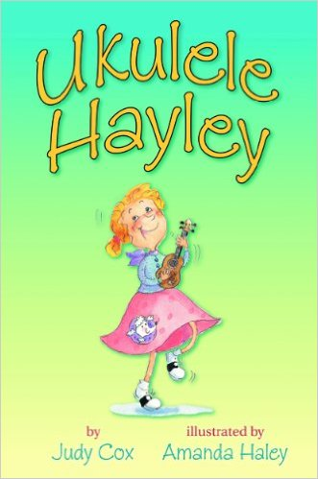
Ukulele Hayley by Judy Cox
Hayley has finally found her talent: playing ukelele like her great-aunt Ruby, who traveled all over with her band, the Ragtime Rascals. She's so enthusiastic that she gets a ukelele band started at school with the new music teacher. Just as the band is getting popular, horrible new comes: the music program and the teacher are being cut. Hayley has a bold idea to help ensure that the school board members change their mind. If only it works....

Slide 8
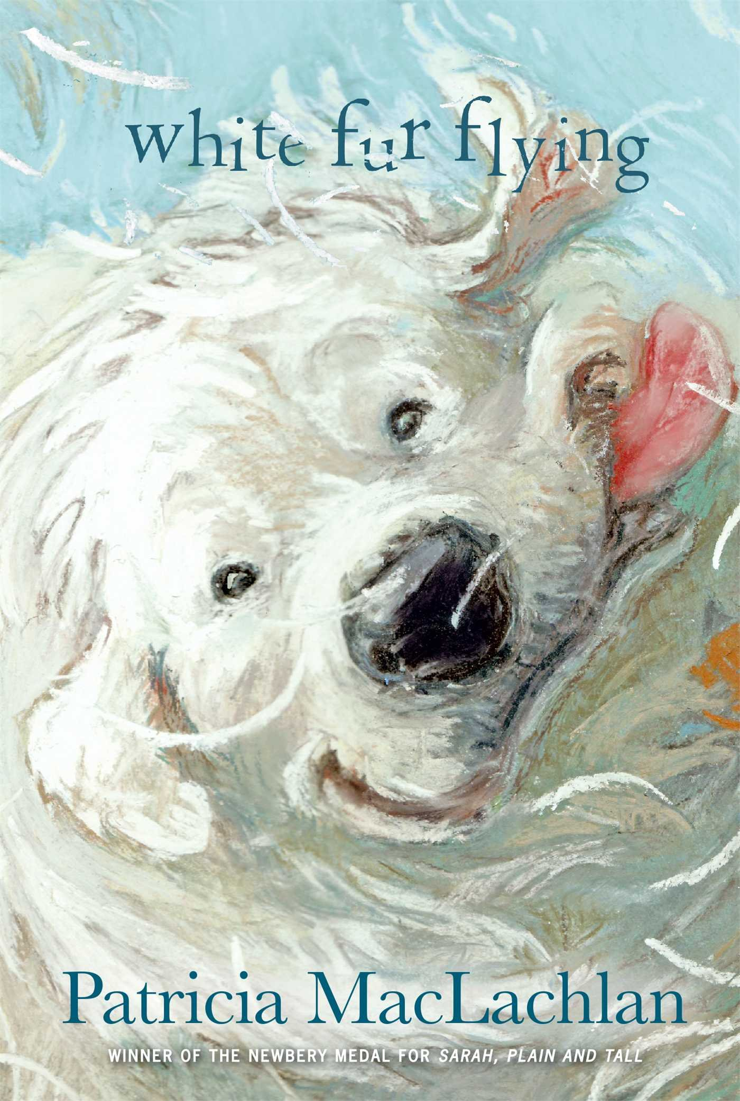
White Fur Flying by Patricia MacLachlan
Zoe’s family rescues dogs in need. There is always the sweet smell of dog and a warm body looking to cuddle or play. There is always a new dog to be saved and loved. Fur flies everywhere. It covers everything. Zoe’s house is never silent. But the house across the street is always silent these days. A new family has moved in and Phillip, the boy, has stopped speaking. He doesn’t even want to try. Zoe knows that saving dogs and saving boys are different jobs, but she learns that some parts are the same. Both take attention and care, understanding and time. And maybe just a bit of white fur flying.

Slide 9
Remember to vote from
March 15 through April 10th
by going onto the BCCCA website
http://ola.memberclicks.net/bccca-how-to-vote

Slide 10
Power Point created by Jennifer Wintersteen
Music, “Sara Lately” copyright Kevin Hamler-Dupras

